Slide 1

Aero 2 – Micro Class

Slide 2





Carlo Boyd
Admin Role:
Manufacturing Engineer
Website Developer
Technical Role:
Fuselage Design Lead
Cale Hines ​
Admin Role: ​
Project Lead
Fundraising Lead ​
Technical Role: ​
Landing Gear Specialist
Luke Chandler
Trey Cooper
Admin Role: ​​
CAD Engineer
Technical Role:
Electronics Lead ​​
Ryan Carberry
Admin Role:
Test Engineer
Technical Role:
Wing Design Lead
Admin Role:
Financial Manager
Technical Role: Aerodynamics Lead

Slide 3

Project Overview
Design a remote-controlled plane capable of carrying a 67fl oz payload and completing a 360-degree course, while taking off within 100ft and landing within 200ft.
Importance: Background knowledge into micro-UAV / drone design. Opportunity for careers in defense and aerospace industry.
First Prototype very close to completion, working on second prototype
Successfully registered for competition in DFW
Current funding: $5000 from Gore + fundraising
Client: David Willy
Technical Advisor: Carson Pete
Competition: SAE Aero (micro class) 2026

Slide 4
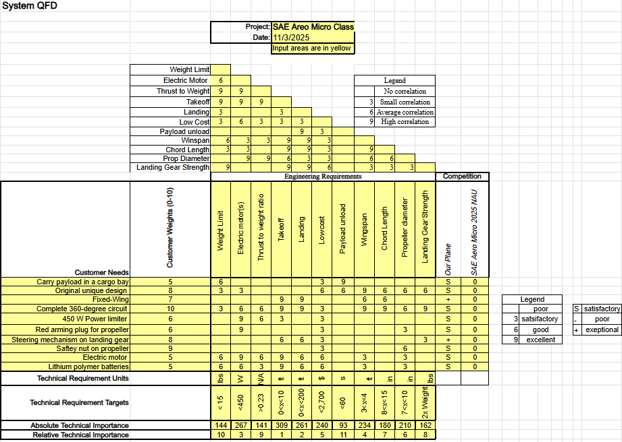
Design Requirements

Slide 5
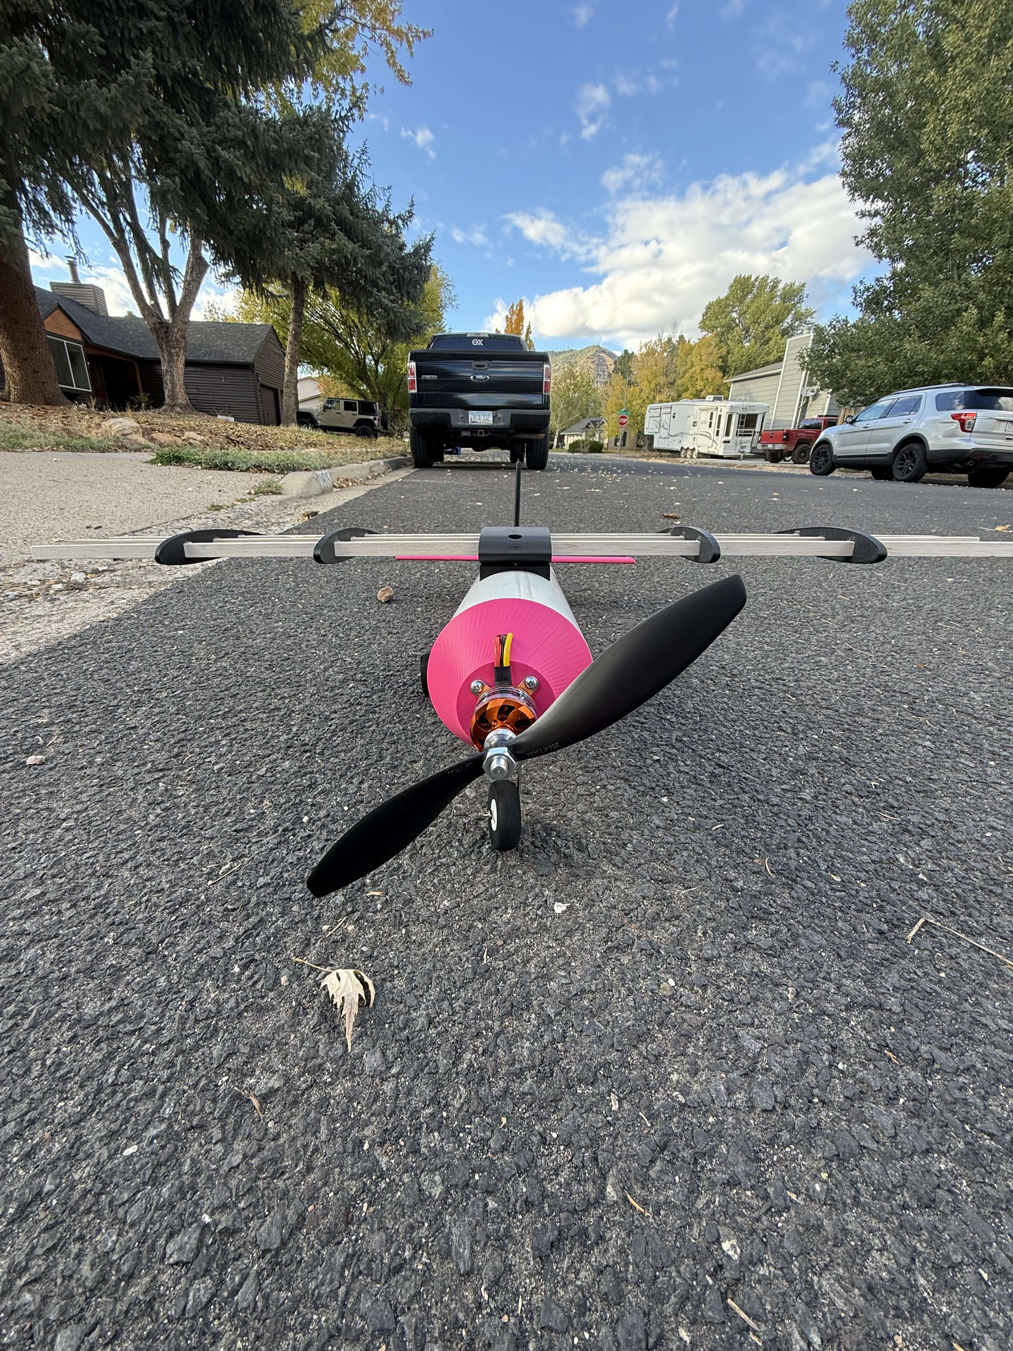
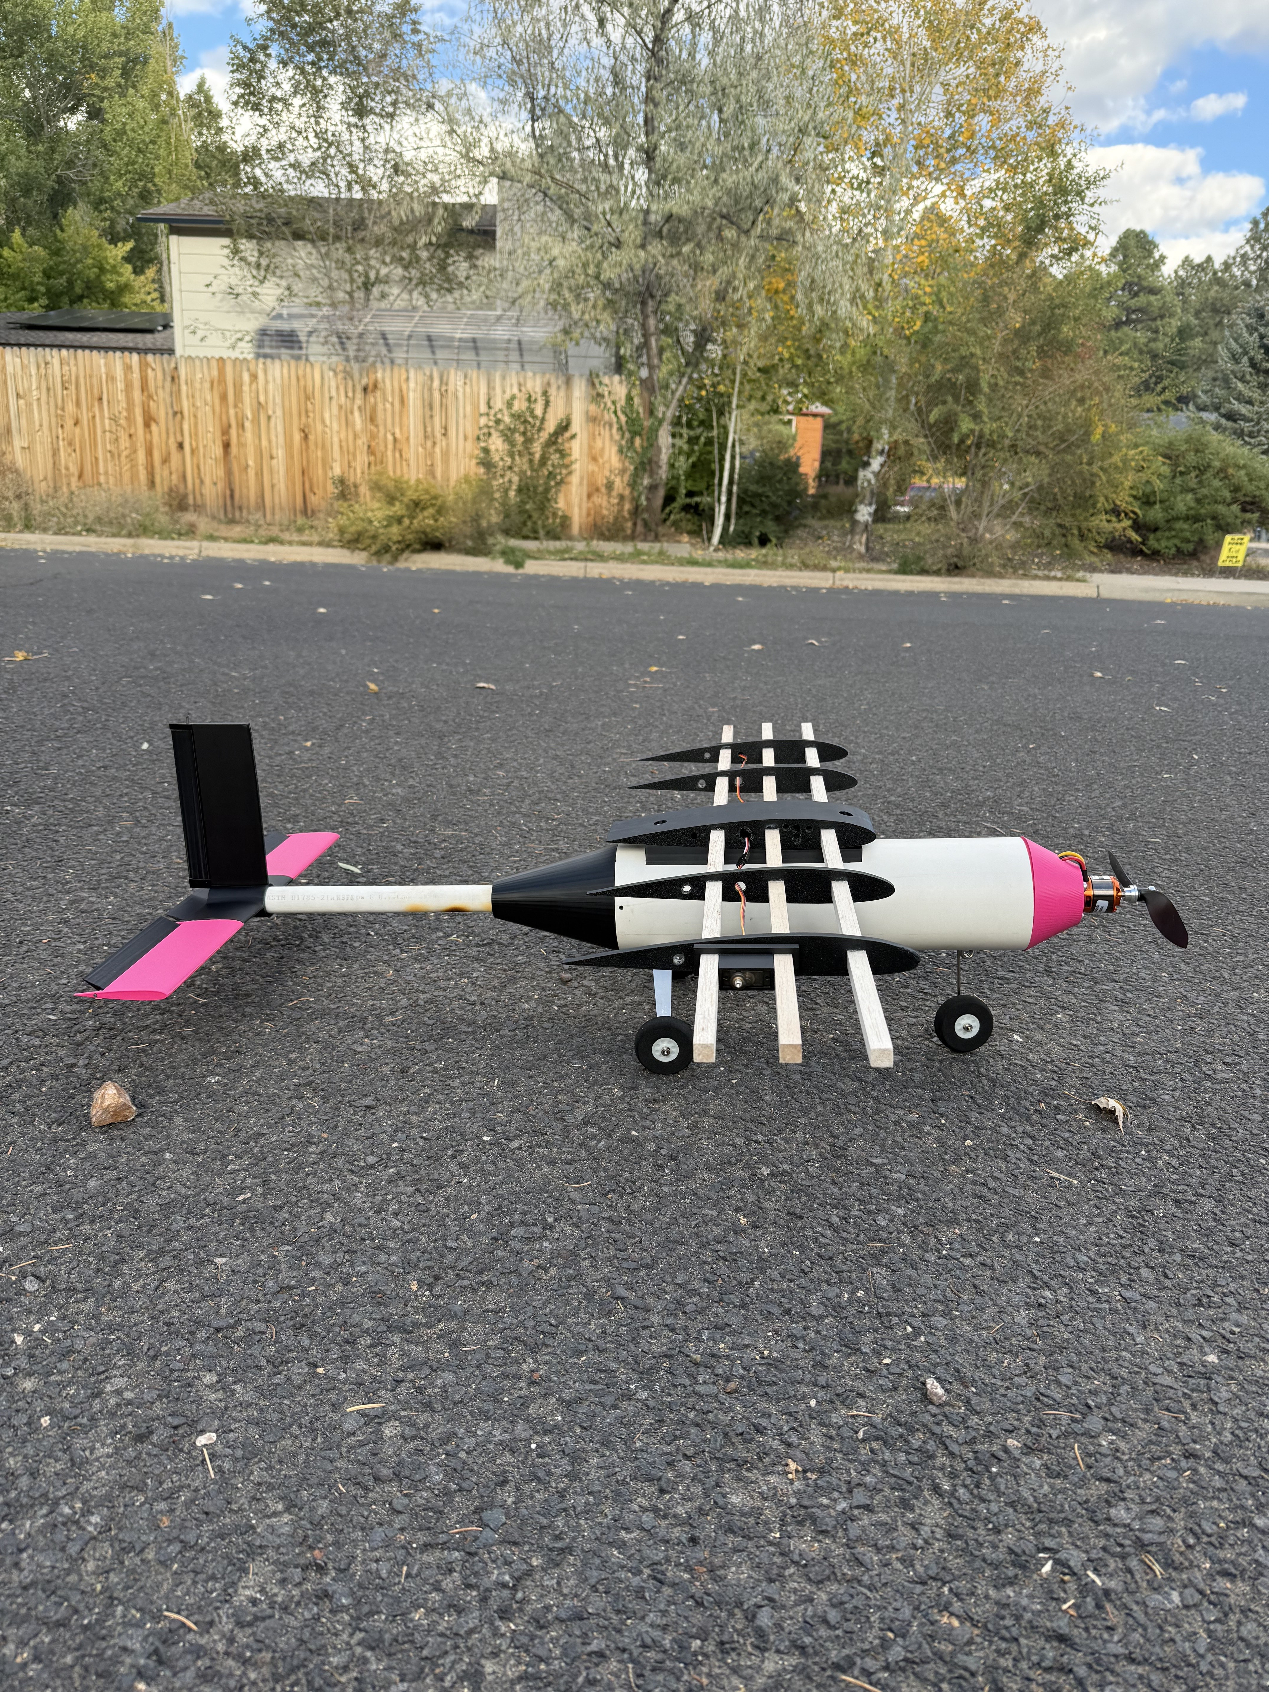
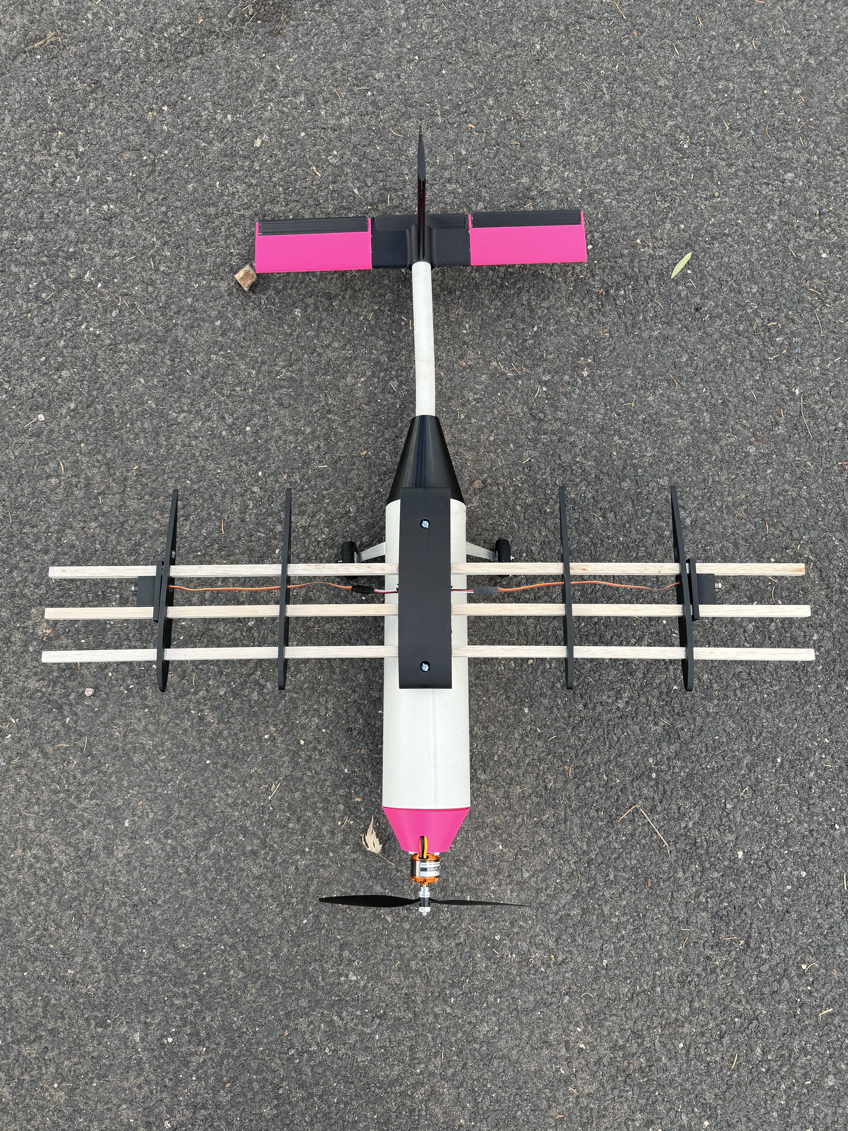
Prototyping Update
Prototype 1 99% Completed
Heavier than expected (14.2 lb)
  Less infill on 3D print
  Slicing software
  Updated CAD files and new prototype 2 designs
Redesign of tail wing
  Control surfaces too small
Potential motor/propellor change
  Lower static thrust value
Wrapping wings and hopefully getting off the ground this week

Slide 6
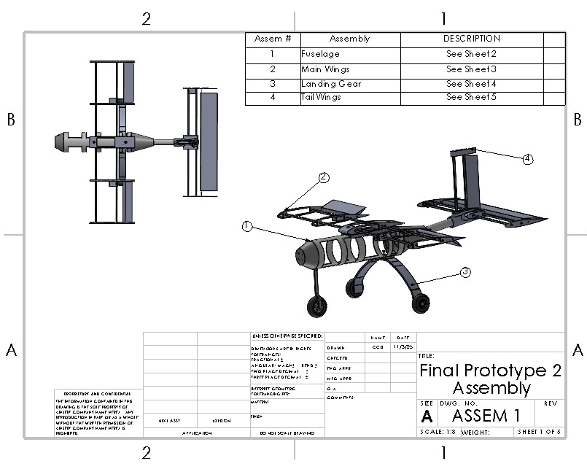
Final Prototype 2 Assembly: Sheet 1
4 Main Sub-Assemblies
  Fuselage
  Main Wings
  Landing Gear
  Tail Wings

Slide 7
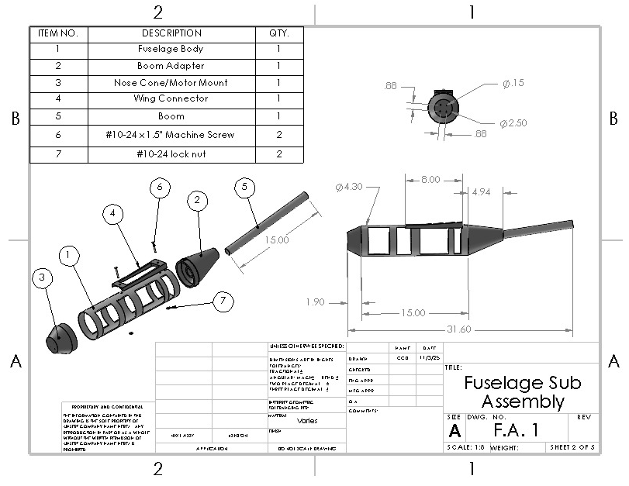
Fuselage Assembly: Sheet 2
Use of solid fuselage with cutout sections
  Decrease weight, keep structural integrity while maintaining mounting surfaces
Angled Boom Adapter
  Increased flight stability, optimized to eliminate wash out
Short and Stubby nose cone
  Decrease skin drag

Slide 8
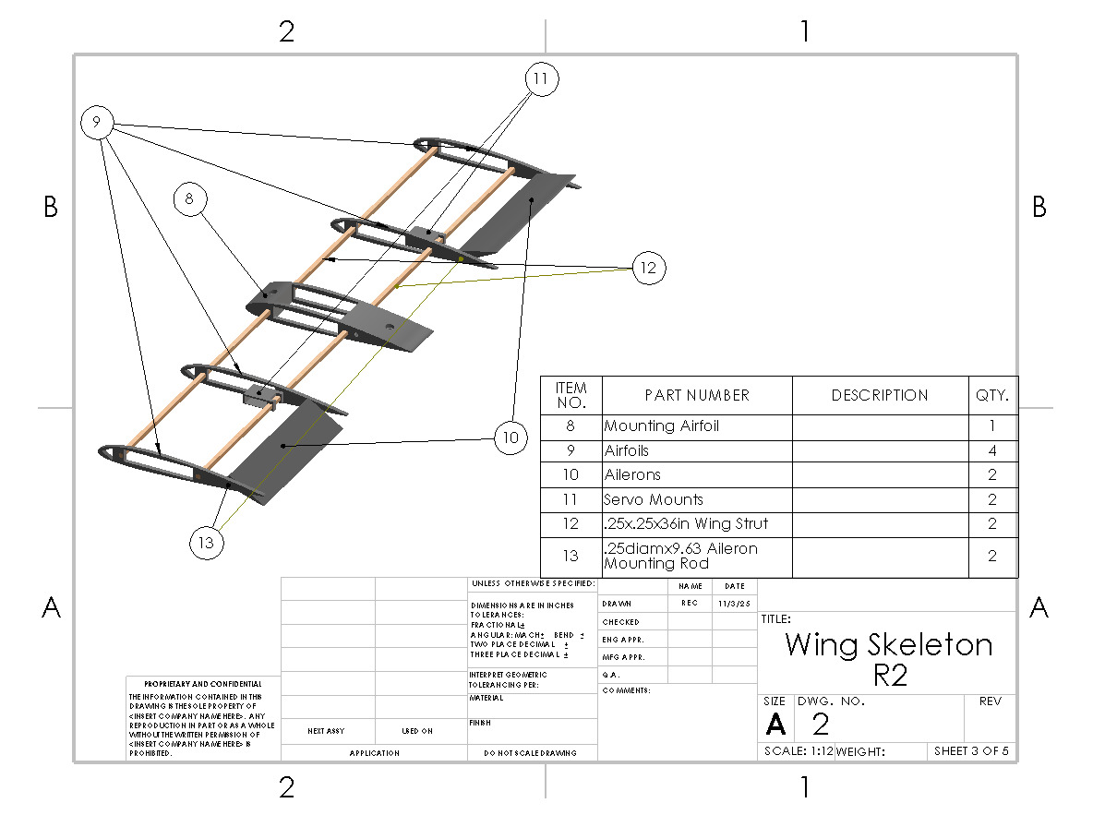
Main Wing Assembly: Sheet 3
Cut-outs in all airfoils to decrease weight and provide room for electrical wires
Servo mounts to securely fasten our servos
Control arms will be mounted under the wing externally
Smaller struts to decrease weight
  3 (½) inch square struts to 2 (¼) inch squares
Circular rods ¼ inch diameter to secure ailerons

Slide 9
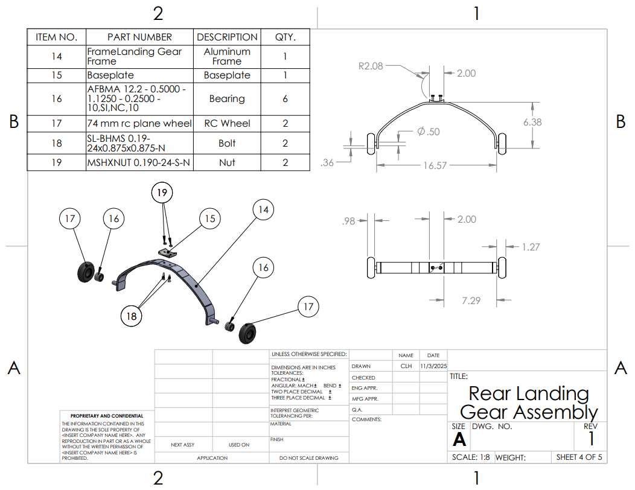
Rear Landing Gear Assembly: Sheet 4
Planning on purchasing rather than designing landing gear but from research these are generally the parts involved with an assembly of a rear landing gear.

Slide 10
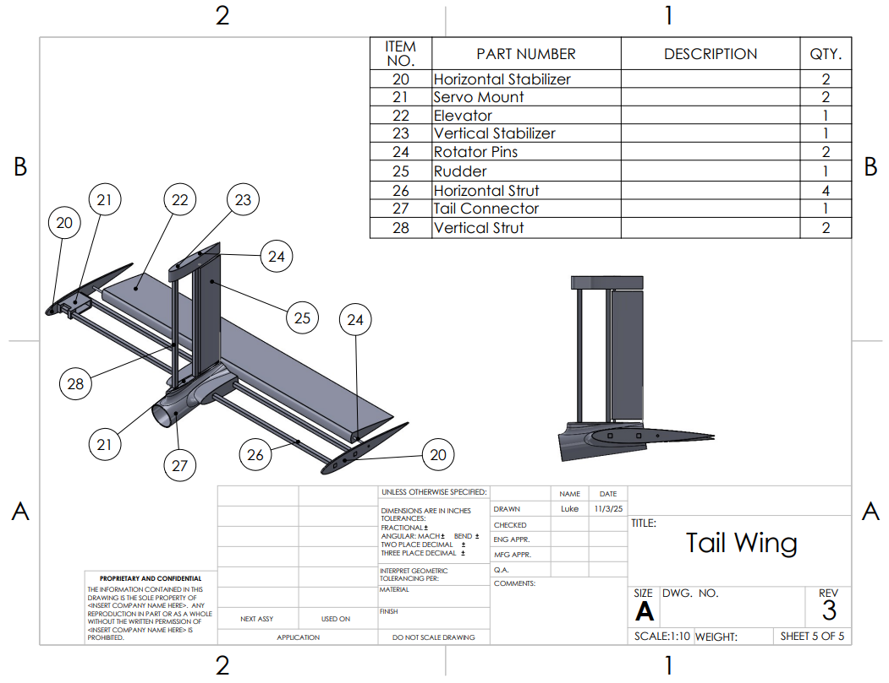
Tail Wing Assembly: Sheet 5
Two balsa wood struts on each side to support the shape of the wings.
Airfoils attached at the ends to support the shape when wrapped.
One large elevator and rudder so only one servo is needed to control each.
Servo mounts attached to the struts to reduce drag.
Boom slides right into the center for easy connection.
Horizontal and vertical stabilizer are attached at an angle to make it level with the boom's angle.

Slide 11
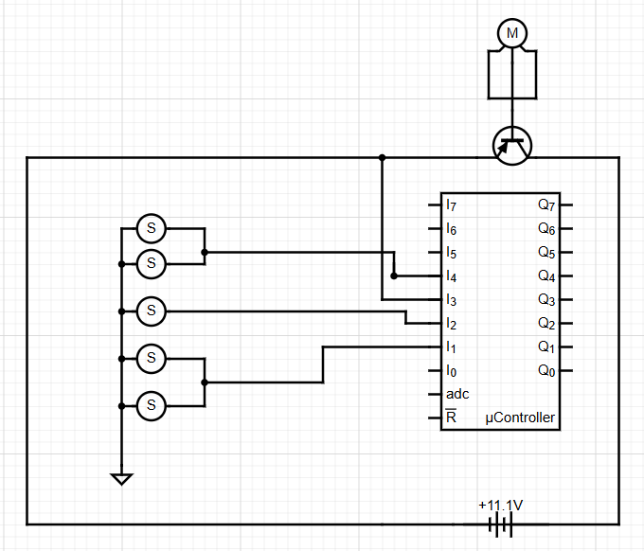
Electrical Diagram
1250 KV motor with 80 Amp ESC
11.1 Volt Battery
Ailerons are connected via splitter cable
Rudder and nose gear are connected via splitter cable

Slide 12
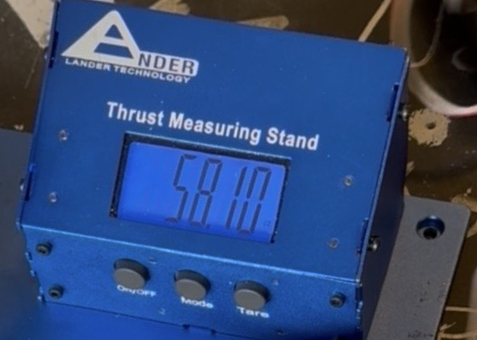
Static Thrust
Current Motor and Propellor combination – 3.63lb Thrust
  Generally static thrust ≥ ¼ total weight
  Allows us to have weight limit of roughly 14.5 lb (current target weight of 8lb without payload).
  Need lower weight to get maximum take off score
Static Thrust to Weight Ratio
Prototype 1— 0.2556:1
Prototype 2— 0.4538:1 (Goal)
Plan to create roof mount to record data for dynamic thrust at various speeds

Slide 13
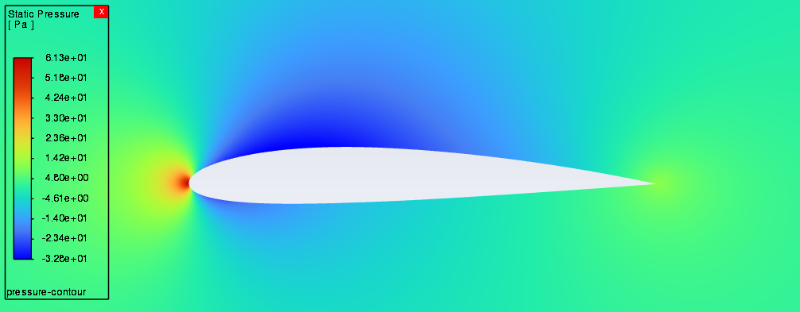
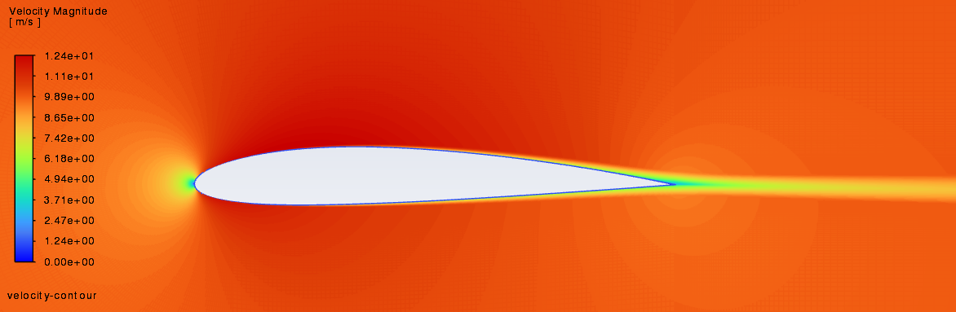
2D Ansys Analysis: 0° AOA
Pressure Contour Map
Highest pressure at leading edge
Lowest pressure above airfoil
Low pressure below airfoil (some lift)
Inlet Velocity Contour Map
High velocities surrounding airfoil
Low velocities at leading and trailing edge
Straight velocity trail behind trailing edge

Slide 14
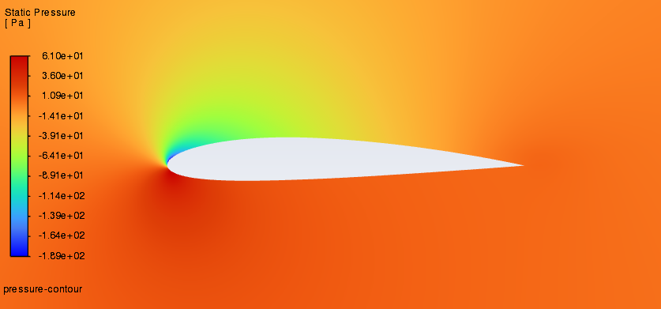
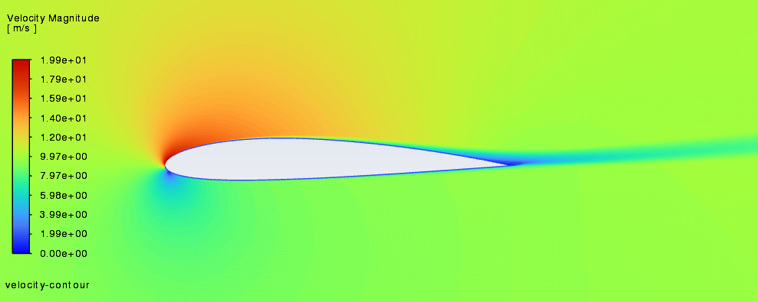
2D Ansys Analysis: 8° AOA
Pressure Contour Map
Low pressure above airfoil
Much higher pressure below airfoil (more lift)
Inlet Velocity Contour Map
High velocities above leading edge
Stagnant point slightly below leading edge
Low velocity trail sloping upwards behind trailing edge

Slide 15
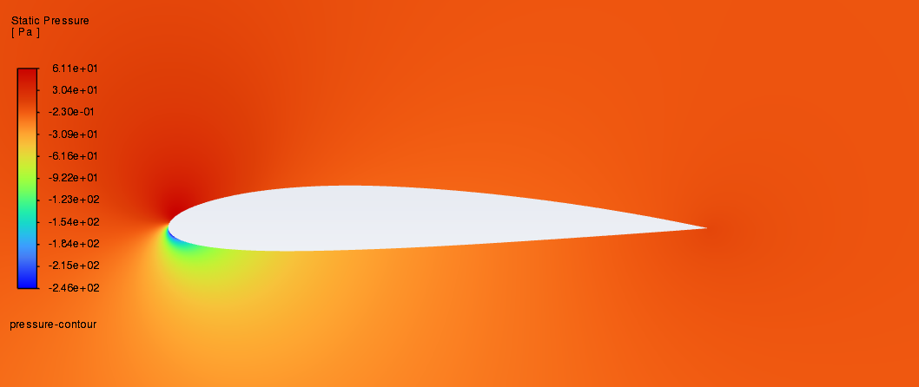
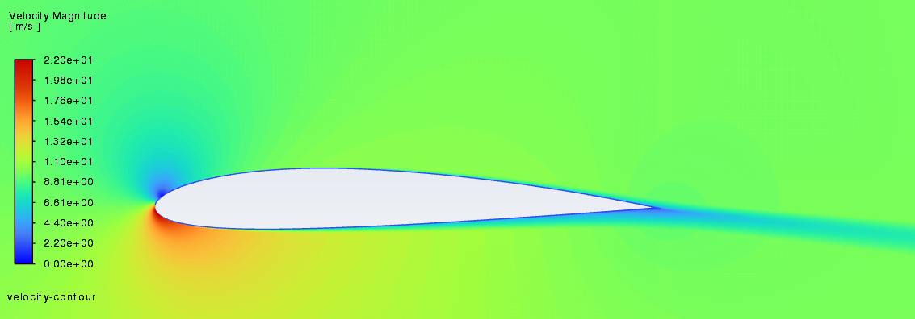
2D Ansys Analysis: -8° AOA
Pressure Contour Map
High pressure above airfoil (negative lift)
Lower pressure below airfoil
Inlet Velocity Contour Map
High velocities below leading edge
Stagnant point slightly above leading edge
Low velocity trail sloping down behind trailing edge

Slide 16
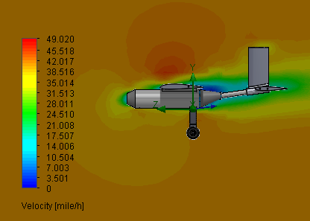
2D SolidWorks Analysis: 8° AOA

Slide 17
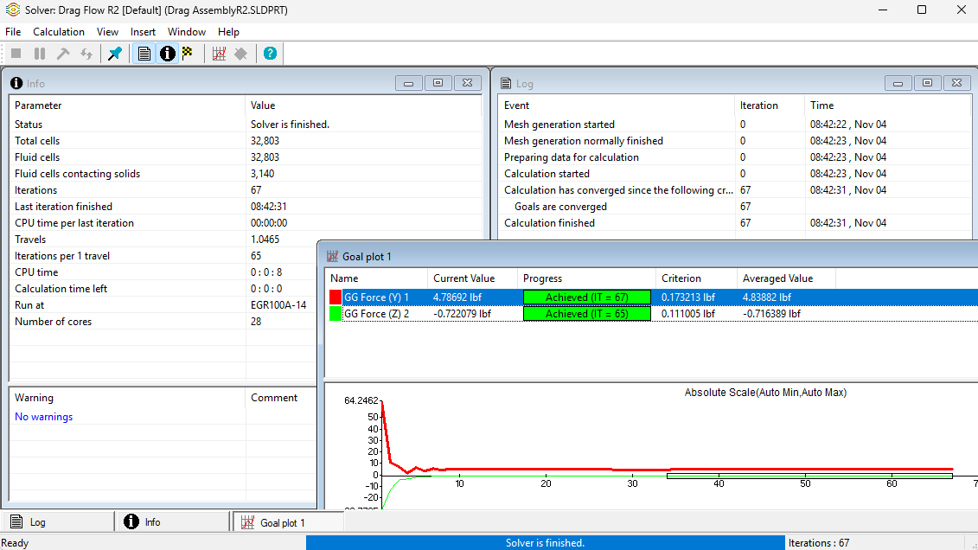
2D SolidWorks Analysis: 8° AOA on Frame

Slide 18


Aileron Calculations
Where:
$C_{lε}$ = aileron lift increase with deflection angle ($ε$)
$C_{lα}$ = lift coefficient over 0° AOA: 0.15
$γ$ = aileron chord length: 2.5 [in]
$S_{aileron}$ = surface area of aileron part of wing: 45 [${in}^{2}$]
$S_{ref}$ = Wing area – aileron part: 315 [${in}^{2}$]
$y_{aileron}$ = spanwise center of aileron part: 13.1875 [in]
$b$ = wingspan: 36 [in]
$ε$ = deflection angle: (±5, ±10, ±15)°[convert to rad]
$q_{∞}$ = dynamic pressure: 0.0871 [$\frac{lb}{{in}^{2}×s}$]
$M$ = dynamic moment [$\frac{lb×in}{s}$]
Findings:
$C_{lε}=C_{lα}×\sqrt{γ}×\frac{S_{aileron}}{S_{ref}}×\frac{y_{aileron}}{b}$
  $C_{lε}=$ 0.0124 (0° AOA)
$M= C_{lε}× ε × S_{ref}×b×q_{∞}$
  $M$ = ± 1.07 [$\frac{lb×in}{s}$] (± 5° $ε$)
  $M$ = ± 2.14 [$\frac{lb×in}{s}$] (± 10° $ε$)
  $M$ = ± 3.21 [$\frac{lb×in}{s}$] (± 15° $ε$)

Slide 19

Wing Calculations: Elevator & Moment Arm
S_{HT}: Area of the horizontal tail
C_{HT}: Volume coefficient
S_{W}: Main wing Area
C_{MAC}: Mean aerodynamic chord
L_{ht} : Distance between the aerodynamic chords on main wing to tail wing
Tail moment or boom length is recommended to be 60% to fuselage length.
Aspect ratio should be less than the main wing and between 3-5.
Elevator should be 25-50% of the chord length
$S_{HT}=\frac{c_{HT∗S_{w}∗C_{MAC}}}{L_{ht}}=118.309{in}^{2}$
$Span=\sqrt{AR∗Area}=18.83in$
${Span}_{e}=.9∗Span=16.956in$
$C_{h}=\frac{118.309}{18.83}=6.28in$
$C_{E}=0.5∗C_{h}=3.14in$

Slide 20

Wing Calculations: Rudder & Aileron
S_{VT} : Area of the horizontal tail
C_{VT} : Volume coefficient
S_{W} : Main wing Area
b: Wing Span
L_{ht} : Distance between the aerodynamic chords on main wing to horizontal stabilizer
Aspect Raito should be between 1.3-2
Rudder should be 25-50% of the chord length
Aileron Span = 50-90% of wing span
Ailerons and Flaps are 15-25% of the wing chord
$S_{VT}=\frac{c_{VT∗S_{w}∗b}}{L_{ht}}=24.338{in}^{2}$
$Span=\sqrt{AR∗Area}=6.976in$
${Span}_{R}=.9∗Span=6.27in$
$C_{V}=\frac{24.338}{6.976}=3.489in$
$C_{R}=0.5∗C_{V}=1.744in$
${Span}_{a}=\frac{b}{2}∗0.5=9in$
$C_{a}=C∗.25=2.375$
Notes:
Our calculations for rudder and aileron followed the same general process as the previous slide.
We plan to have a rudder that is 7.8 x 3.7 inches
And a aileron that is 9 x 2.3 inches
Now that we've done these calculations, were confident that we will have better control authority

Slide 21
Customer/ Competition Requirements:
Status Update
Carry payload in a cargo bay
  Prototype 3 focus point
  Bladder
Complete 360-degree circuit
  Prototype 2 and 3
Red arming plug for propeller
  Prototype 3
Steering mechanism on landing gear
  Prototype 2
Safety nut on prop (spinner)
  Prototype 2
***LiPo Batteries, Electric Motor, 450W Power Limiter, Fixed Wing Concept, and unique design all addressed in Prototype 1.

Slide 22
Engineering Requirements:
Status Update
Weight Limit < 55 lb--- Team requirement < 15 lb
  Current Goal Weight 8lb
Thrust to Weight Ratio: 0.23 < Current Static Thrust to Weight
Takeoff: 0<x<100 [ft]-- Team requirement <10ft
  Prototype 2 and 3
Landing: x<200 [ft]
  Prototype 2 and 3
Payload unload < 60 [s]
  Prototype 3

Slide 23
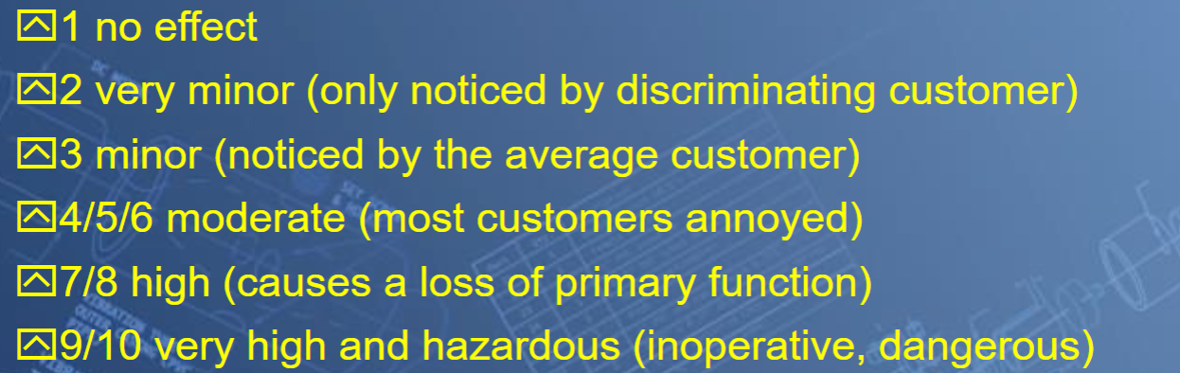
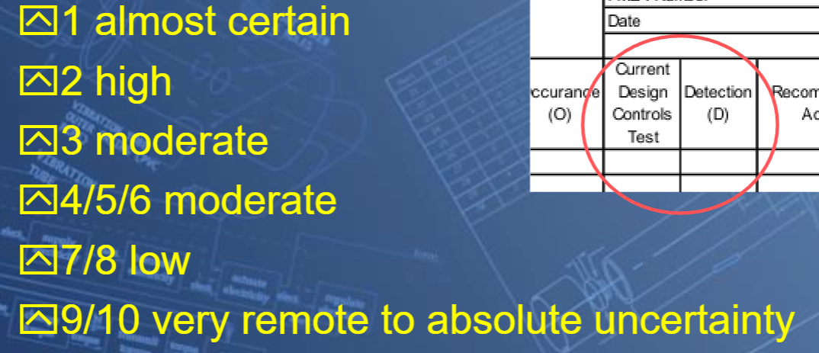
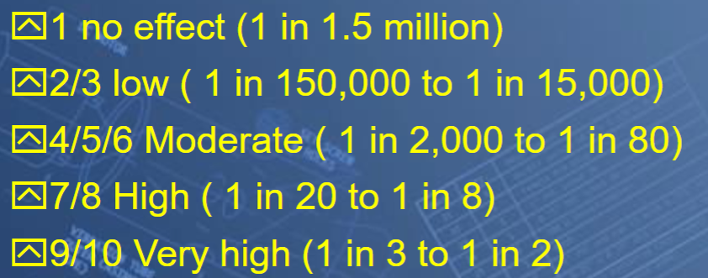
Design Validation
Severity Scale
Detection Scale
Occurrence Scale
Notes:
This is a overview of the scales we pulled from the FMEA powerpoint
These scales describe how visible, how likely, and how catastrophic a failure would be
The higher the number the more negative the outcome

Slide 24
Design Validation - FMEA
Part # and Functions | Potential Failure Mode | Potential Effect(s) of Failure | Severity (S) | Potential Causes and Mechanisms of Failure | Occurance (O) | Current Design Controls Test | Detection (D) | RPN | Recommended Action
3. Nose Cone/Motor Mount | Motor could come loose | Loss of thrust, Flying Debris | 9 | *Infill of motor mount could be too low * Mount is not properly fastened to fuselage | 2 | Measure distance between bracket and mount | 1 | 18 | Use higher infill percentage (currently 30%, use 35%)
1. Fuselage | Yield under load | Disassemebly of aircraft | 10 | Stress concentration within fuselage | 2 | Load Test | 1 | 20 | Simulate loads in Ansys, Eliminate stress concentration points such as sharp corners in fuselage
2. Boom Adapter | Could come loose, shear in bolts | Total loss of control | 10 | Infill near nuts too low, too much force from tail wing | 2 | Load test | 1 | 18 | Slicing software for thicker infill near nuts
5. Boom | Yield under load | Disassemebly of aircraft | 10 | Stress concentration within boom | 2 | Load Test | 1 | 20 | Eliminate stress concentration points such as sharp corners in boom
24. Stabilizer Connector | Fasteners could become loose | Disassemebly of aircraft | 5 | Loads could exceed strength of fasteners | 5 | Load Test using weight hanging from tail vertically | 1 | 25 | Use additional fasteners
23. Vertical Stabilizer | Ribs could slide along stringer | Unstable flight | 9 | Insufficient force to keep ribs in place | 5 | Measure distance between outboard rib and end of stringer | 1 | 45 | Screw outboard ribs in place
Notes:
We identified over 27 failure modes and the ones with the highest RPN related to structural failures, and control surfaces failing to return to their neutral point
We mitigated these issues by eliminating points of stress concentration such as sharp corners and controlling the placement of servos so that control surfaces deflect evenly

Slide 25
FMEA -Continued
25. Rudder | Control surface could fail to return to neutral | Yaw to one direction | 3 | Servo arm moves upon activation Linkage stopper becomes loose | 5 | Measure distance between control surface end point and neutral point | 8 | 120 | Examine control surface prior to flight
20. Horizontal Stabilizer | Structure could cant due to being improperly fastened | Unstable flight | 9 | Insufficient force to keep ribs in place | 5 | Determine if stabilizer is level using spirit level | 1 | 45 | Examine stabilizer prior to flight
22. Elevators | Control surface could fail to return to neutral | Pitch in one direction | 3 | Servo arm moves upon activation Linkage stopper becomes loose | 5 | Measure distance between control surface end point and neutral point | 8 | 120 | Examine control surface prior to flight
8-13. Wing | Tear in wrap, struts braking | Flight instability and high likelyhood of crash | 8 | *wrapping too tight *large gaps in airfoils on wing skeleton *Crashing | 7 | Load test Experimenting with wrap | 3 | 168 | strong leading edge, eliminate wrap fludder through experimentation
6. Wing Connector Bolts | Bolts could shear or come loose in the infill | Complete loss of wings or wings becoming loosly mounted | 10 | *Too low of infill on 3D print *Shear force on bolts | 5 | Testing forces on wings before flight | 2 | 100 | Higher infill percentage or redesign
9. Ailerons | Control arm disconnecting Connection rod breaking | Loss of control surfaces on main wings, airplane only controlled from tail | 8 | *loose connections Servo arm moves upon activation Linkage stopper becomes loose | 3 | Shear Calculations, strong control arm mounts | 7 | 168 | Stronger materials for connection rod and control arm

Slide 26
FMEA -Continued
29. Motor | Thermal Fatigue Leads could break | Loss of Thrust | 7 | Sustained operation at high RPM | 2 | Measure temperature at high throttle settings using infared thermometer | 2 | 28 | Reduce the amount of time operating at high throttle settings Reduce Tension on motor leads
30. Servos | Wire could break Servo arm could become loose Servo could dismount from tray | Loss of control | 9 | Tension on servo wire | 3 | Functionality Test prior to flight | 1 | 27 | Nail servos to servo tray
31. ESC | Thermal Fatigue Leads could break | Loss of Thrust | 7 | Sustained operation at high RPM | 2 | Measure temperature at high throttle settings using infared thermometer | 2 | 28 | Reduce the amount of time operating at high throttle settings Reduce Tension on ESC leads
32. Battery | Charge could run out during flight Battery could overheat | Loss of control | 10 | High current draw Reduced battery capacity from wear | 2 | Measure battery voltage prior to flight | 2 | 40 | Introduce cooling vents into nose cone to allow airflow through fuselage
33. Receiver | Loss of signal | Loss of control | 9 | Physical damage | 2 | Functionality Test prior to flight | 1 | 18 | Store receiver away from other components
34. Propeller | Yield under load Brittle Fracture | Loss of Thrust | 10 | Physical damage | 4 | Functionality Test prior to flight | 1 | 40 | Examine propeller prior to flight
3b, 2b. Nose Cone and Boom Adapter bolts | Bolts could shear or come loose in the infill | Complete loss of power and stability | 10 | *low infill on 3D print *Bolts not tightened | 2 | Shear Calculations | 3 | 60 | *Higher infill near near the nut holders
14-19. Landing Gear | Yield under load | Damage to aircraft Flying debris | 9 | *Improper fastening * Material defects or damage | 2 | Drop test | 2 | 36 | Use strong materials such as carbon fiber

Slide 27
Design Validation
Testing Procedures
Equipment, Resources, Space​
Bench​/Machine Shop Locker
Open space with paved "runway" (Foxglenn Park)
Center of Gravity Stand​
Tape Measure & Cones
Engineering Requirement | Test Procedure
Weight Limit < 55lbs | Measure aircraft weight using scale
Takeoff: 0<x<100 [ft] Landing: x<200 [ft] | Measure distances using cones
Flyable at empty weight CG position | Measure using CG stand
Water container drain time <60 seconds | Measure using timer
Risk Trade Off Analysis Summary
Although adding additional fasteners will increase the weight of our aircraft, it will decrease the risk of a structural failure
Notes:
Our testing procedures for next semester will be simple
Our main engineering requirements consist of having a aircraft under 55lbs, takeoff and landing distance within limits, flyable CG without our battery or payload, and a water container that can drain within the time limit.
To test these we will use a scale to measure weight, we'll use a tape measure and equally spaced cones to measure distances

Slide 28
Budget
Overview
 | Projected | Actual | Difference
Total income | $ 10,000 | $ 8,295 | -$ 1,705
Expenses | $ 5,325 | $ 1,906 | -$ 3,419
Balance | $ 4,675 | $ 6,389
Item | Cost
Nut,Bolts,Screws,Misc | $25.53
Wire | $3.79
Dowels | $0.99
Balsa Wood Struts | $24.99
PVC Fuselage | $25.99
PVC Boom | $4.97
Motor | $19.99
3D Filament | $24.99
Servos | $23.98
Speed Controller | $37.49
Servo Ext | $7.99
Landing Gear | $14.97
Propellers | $15.99
Glue | $11.98
Description | Category | Projected cost | Actual cost | Difference
Cost of comp | Registration Fee | $1,650.00 | $1,650.00 | $-
Prototype 1 | Plane Design | $250.00 | $256.42 | $(6.42)
Prototype 2 | Plane Design | $250.00 |  | $250.00
Prototype 3 | Plane Design | $250.00 |  | $250.00
Final Model | Plane Design | $700.00 |  | $700.00
Money for travel to comp | Transportation | $1,500.00 |  | $1,500.00
Income summary
 | Projected | Actual | Difference
Initial Donation | $ 5,000 | $ 5,000 | $ 0
Fundraising | $ 5,000 | $ 3,295 | -$ 1,705

Slide 29
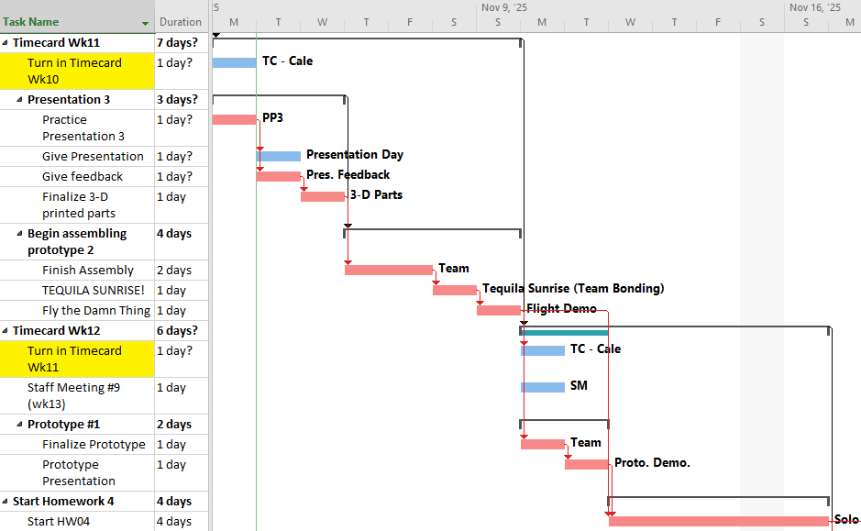
Gantt Chart

Slide 30
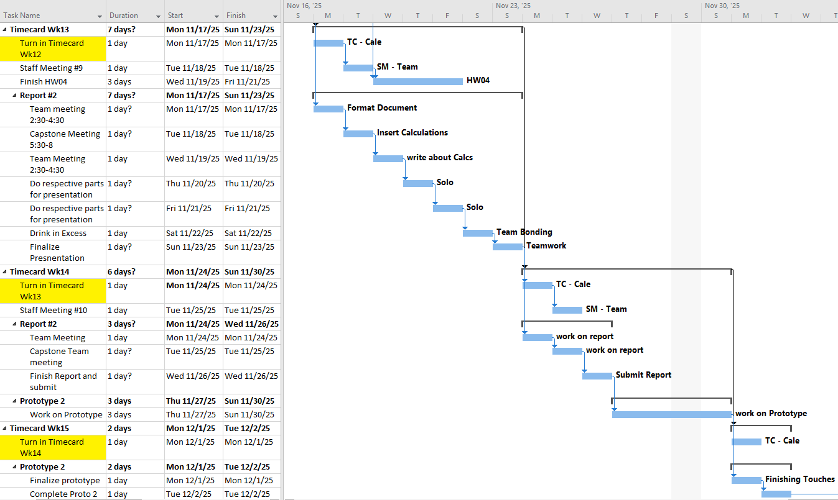
Gantt Chart continued

Slide 31

Questions

